Slide 1
(Short) Introduction to Machine Learning
Alberto TONDA, Senior Researcher (DR)
UMR 518 MIA-PS (Applied Mathematics and Computer Science) INRAE, AgroParisTech, Université Paris-Saclay Institut des Systèmes Complexes, Paris-Ile-de-France

Slide 2

Outline
What is machine learning
ML as optimization
Supervised ML
Unsupervised ML
Fighting overfitting

Slide 3
Machine learning (more proper definition)
Given a class of tasks T, a performance measure P, and experience E, a machine learning algorithm improves its performance measured with P, for tasks in T, using the experience E

Slide 4
Machine learning (more proper definition)
Given a class of tasks T, a performance measure P, and experience E, a machine learning algorithm improves its performance measured with P, for tasks in T, using the experience E

Slide 5
Machine learning as optimization
Learn a task directly from examples
No need for symbols, just large quantities of data
Samples (rows) and features (columns)
“Dirty secret” of ML: it’s mostly optimization
Restate learning task as optimization task
Solve it relying on available (training) data
Learning Task
Optimization Task

Slide 6
Machine learning as optimization
What does “restating” the problem mean?
Variables to optimize: parameters of the model
Create an objective function related to your learning problem
Optimizing the objective function also solves your problem
Types of machine learning
Supervised: we have labeled data (correct answers, ground truth)
Common tasks: classification, regression
Unsupervised: we do not have labeled data
Common tasks: clustering, dimensionality reduction; also the base of advanced techniques, such as image/text generation

Slide 7
Vocabulary
Model: one candidate solution (regressor/classifier)
Model parameters
Values (numerical, categorical, …) inside the model
Optimized (e.g. change values) during training process
Training data: data from which we want to learn
Test data: unseen data, kept aside to assess generalization
Validation data: used during training, not for training (!)
Training/Fit: optimize parameter values to fit training data

Slide 8
Vocabulary
Model hyperparameters
Choices/parameters outside the model
Usually user-defined before training process starts
Capacity (loose definition)
Maximum order of function that can be approximated by model
The more parameters, the more capacity
Bias: source of errors, not enough capacity (underfitting)
Variance: sensitivity to small variations in training data, too much capacity (overfitting)

Slide 9

Supervised machine learning
How would you construct our objective function for ML?

Slide 10
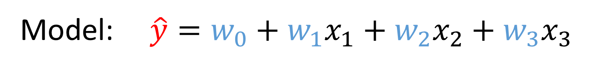

Supervised machine learning
Regression
Minimize (squared/abs) difference predictions - training data
Way of optimizing depends on the structure of the model
After optimization, R2/MSE is usually used as a metric of quality
Features: $y, x_{1},x_{2},x_{3}$
Model: $\hat{y}=w_{0}+w_{1}x_{1}+w_{2}x_{2}+w_{3}x_{3}$
Optimization task: $argmin(\sum_{i=0}^{N}{| \hat{y}(i) −y(i) |)}$

Slide 11
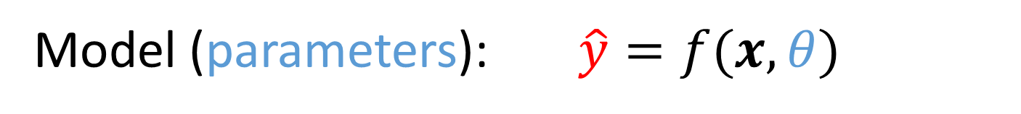

Supervised machine learning
Regression
Minimize (squared/abs) difference predictions - training data
Way of optimizing depends on the structure of the model
After optimization, R2/MSE is usually used as a metric of quality
Features: $y, x$
Model (parameters): $\hat{y}=f(x, θ)$
Optimization task: $argmin(\sum_{i=0}^{N}{| \hat{y}(i) −y(i) |)}$

Slide 12
Supervised machine learning
Regression
Minimize (squared/abs) difference predictions - training data
Way of optimizing depends on the structure of the model
After optimization, R2/MSE is usually used as a metric of quality
Sometimes called “problem variables” in ML
Features: $y, x$
Model (parameters): $\hat{y}=f(x, θ)$
Optimization task: $argmin(\sum_{i=0}^{N}{| \hat{y}(i) −y(i) |)}$
From an optimization point of view, these are variables!

Slide 13
Supervised machine learning
Classification
During training, sometimes treated as continuous optimization
E.g. interpret continuous output as probability of class

Slide 14
Supervised machine learning
Classification
Evaluating a trained model: accuracy, % of correct answers
F1 and Matthew’s Correlation Coefficient are better

Slide 15

Overfitting and regularization
ML model has been trained on data
It fits the training data really well
It DOES NOT generalize for unseen data
The trained model captures unique properties of the training data…
…that only exist for those data
How can we evaluate overfitting?
Image generated by AI, prompt “The concept of overfitting in machine learning as the final boss monster in a videogame”

Slide 16

Overfitting and regularization
Hide part of the available data, use it only for test
Ok, but we could be just lucky! We can do better
k-fold cross-validation (k=5 or 10)
Divide data into k parts (splits)
Iterate k times
Each time, use k-1 splits for training
One split for testing
Obtain an average and a stdev of performance
Large stdev usually indicates issues

Slide 17

Overfitting and regularization
Optimizing for maximal fitting is not enough
Also need to add penalties for overfitting
But how?

Slide 18

Unsupervised machine learning
There is no ground truth, no labels; what can we optimize?

Slide 19
Clustering
State-of-the-art algorithms
Hierarchical agglomerative clustering
Density-Based Spatial Clustering of Applications with Noise (DBSCAN)
Hierarchical DBSCAN

Slide 20
Dimensionality reduction

Slide 21
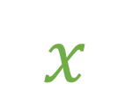
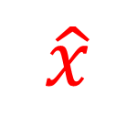
Autoencoders
Train ML algorithm to exactly reproduce the input
Optimization task: $argmin(\sum_{i=0}^{N}{| \hat{x}(i) −x(i) |)}$
Autoencoder
$$x$$
$$\hat{x}$$

Slide 22
Autoencoders
Force the computation to go through bottleneck
Dimension of the bottleneck much smaller than input
…
…
…
…
Bottleneck/Latent space

Slide 23
Autoencoders
Remove the second part of the model
…
…

Slide 24
Autoencoders
Remove the second part of the model
Going from input to (lower dimensionality) bottleneck
Dimensionality reduction
…
…

Slide 25
Autoencoders
However, we can also remove the first part
From the bottleneck to the output
…
…

Slide 26
Autoencoders
However, we can also remove the first part
From the bottleneck to the output
Generation of content
…
…

Slide 27
Practical issues with machine learning
Algorithms find correlations not causal relationships

Slide 28

Practical issues with machine learning
Black-box effect

Slide 29




Societal issues with machine learning
Ethical implications
Bias in the data
Black-box effect
Unintended consequences
Further reading (divulgation)
https://callingbullshit.org/
Weapons of Math Destruction
The Age of Surveillance Capitalism
Toxic Data

Slide 30
Practical advice (July 2023)
Supervised ML
Try all the algorithms with default values, pick the best
Or run “AutoML” approaches (next step)
If you do not have the time to do that
For images: a convolutional neural network (CNN)
For text: transformer neural networks (or Word2Vec)
For tabular data: XGBoost, LightGBM, or Random Forest
For time series: …nothing really works better than other systems

Slide 31


Questions?
Bibliography - Kochenderfer & Wheeler, Algorithms for Optimization, MIT Press, 2019 - De Jong, Evolutionary Computation: A Unified Approach, 2016
Images and videos: unless otherwise stated, I stole them from the Internet. I hope they are not copyrighted, or that their use falls under the Fair Use clause, and if not, I am sorry. Please don’t sue me.

